Slide 1
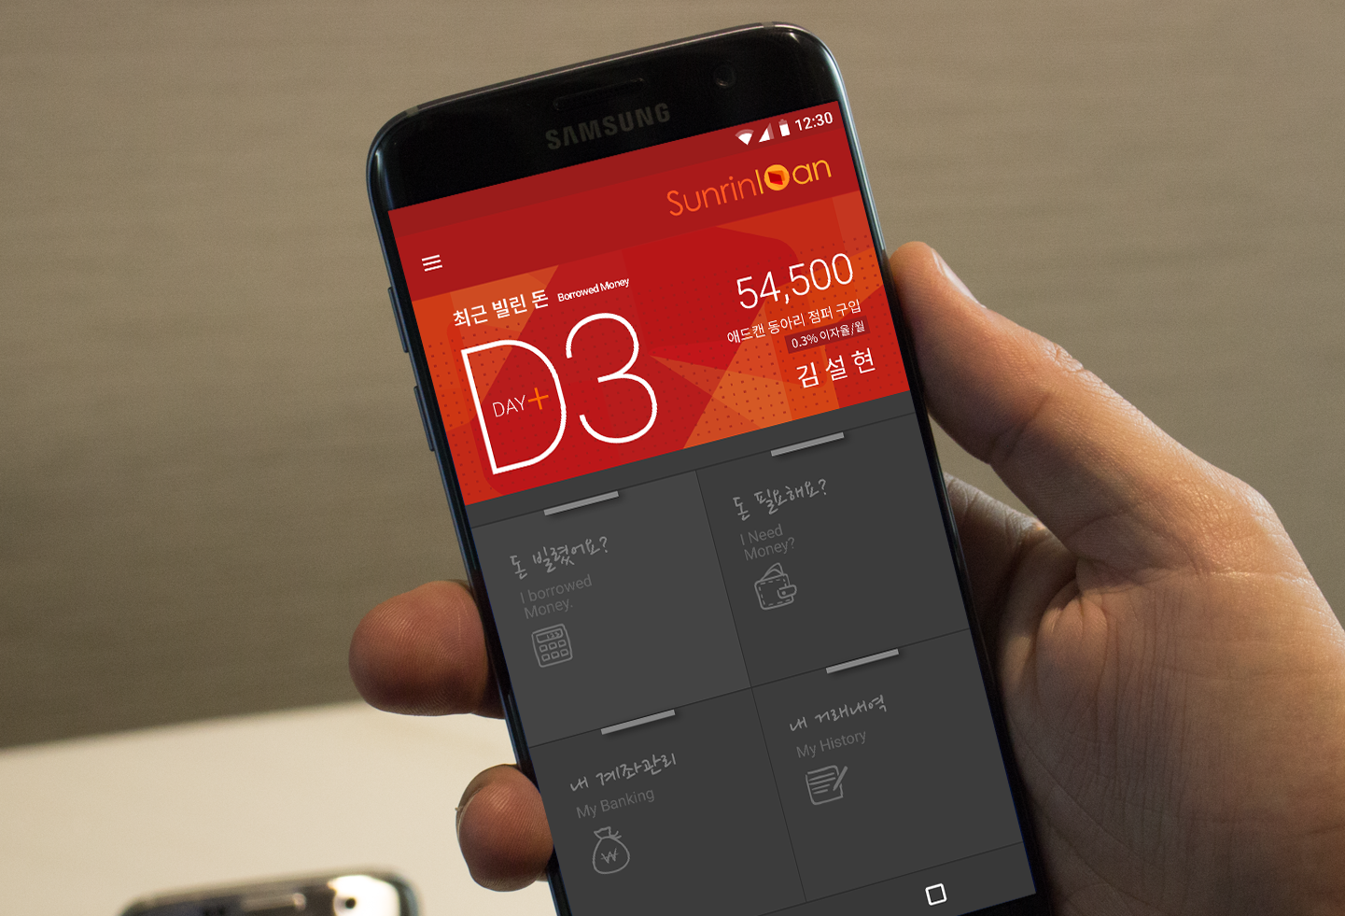

DESIGN
ORDER

Slide 2
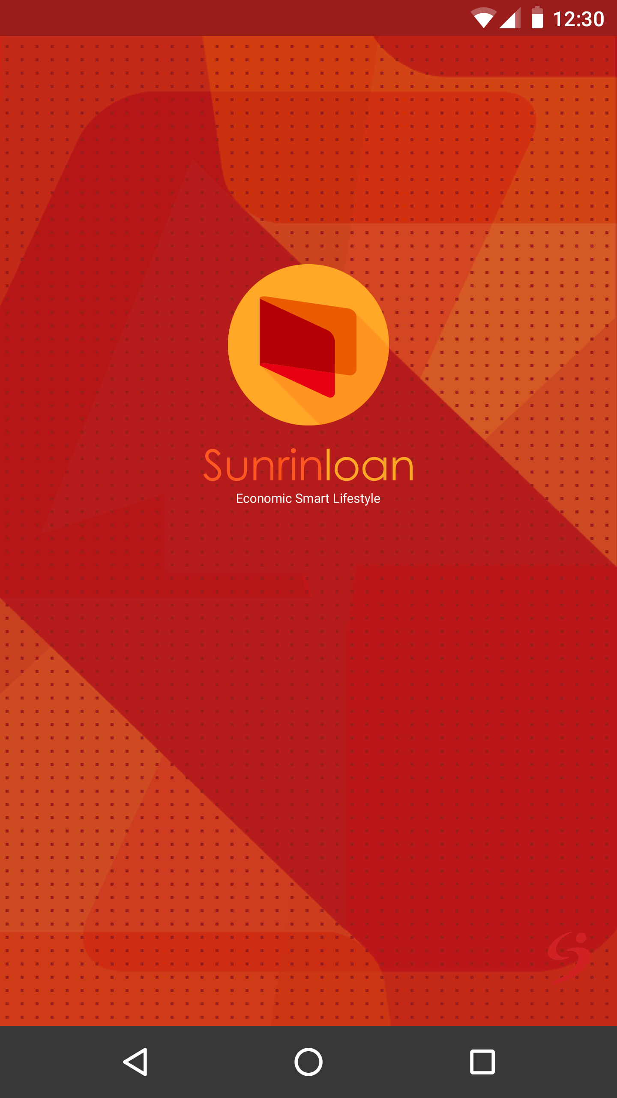
17.50dp
119.50dp
15.50dp
24dp
SPLASH PAGE

Slide 3
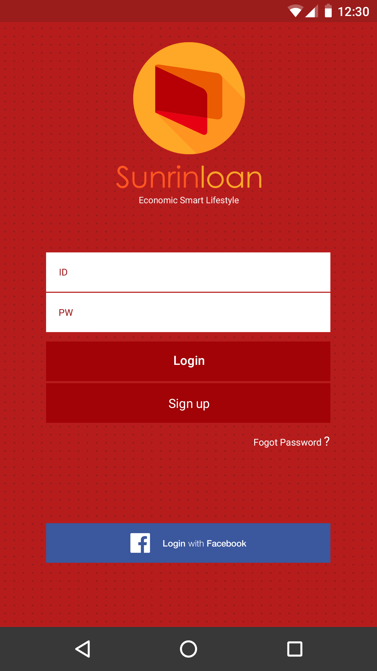
19dp
110dp
45dp
간격 1dp
간격 9dp
간격 2dp
15dp
45dp
61.50dp
LOGIN PAGE

Slide 4
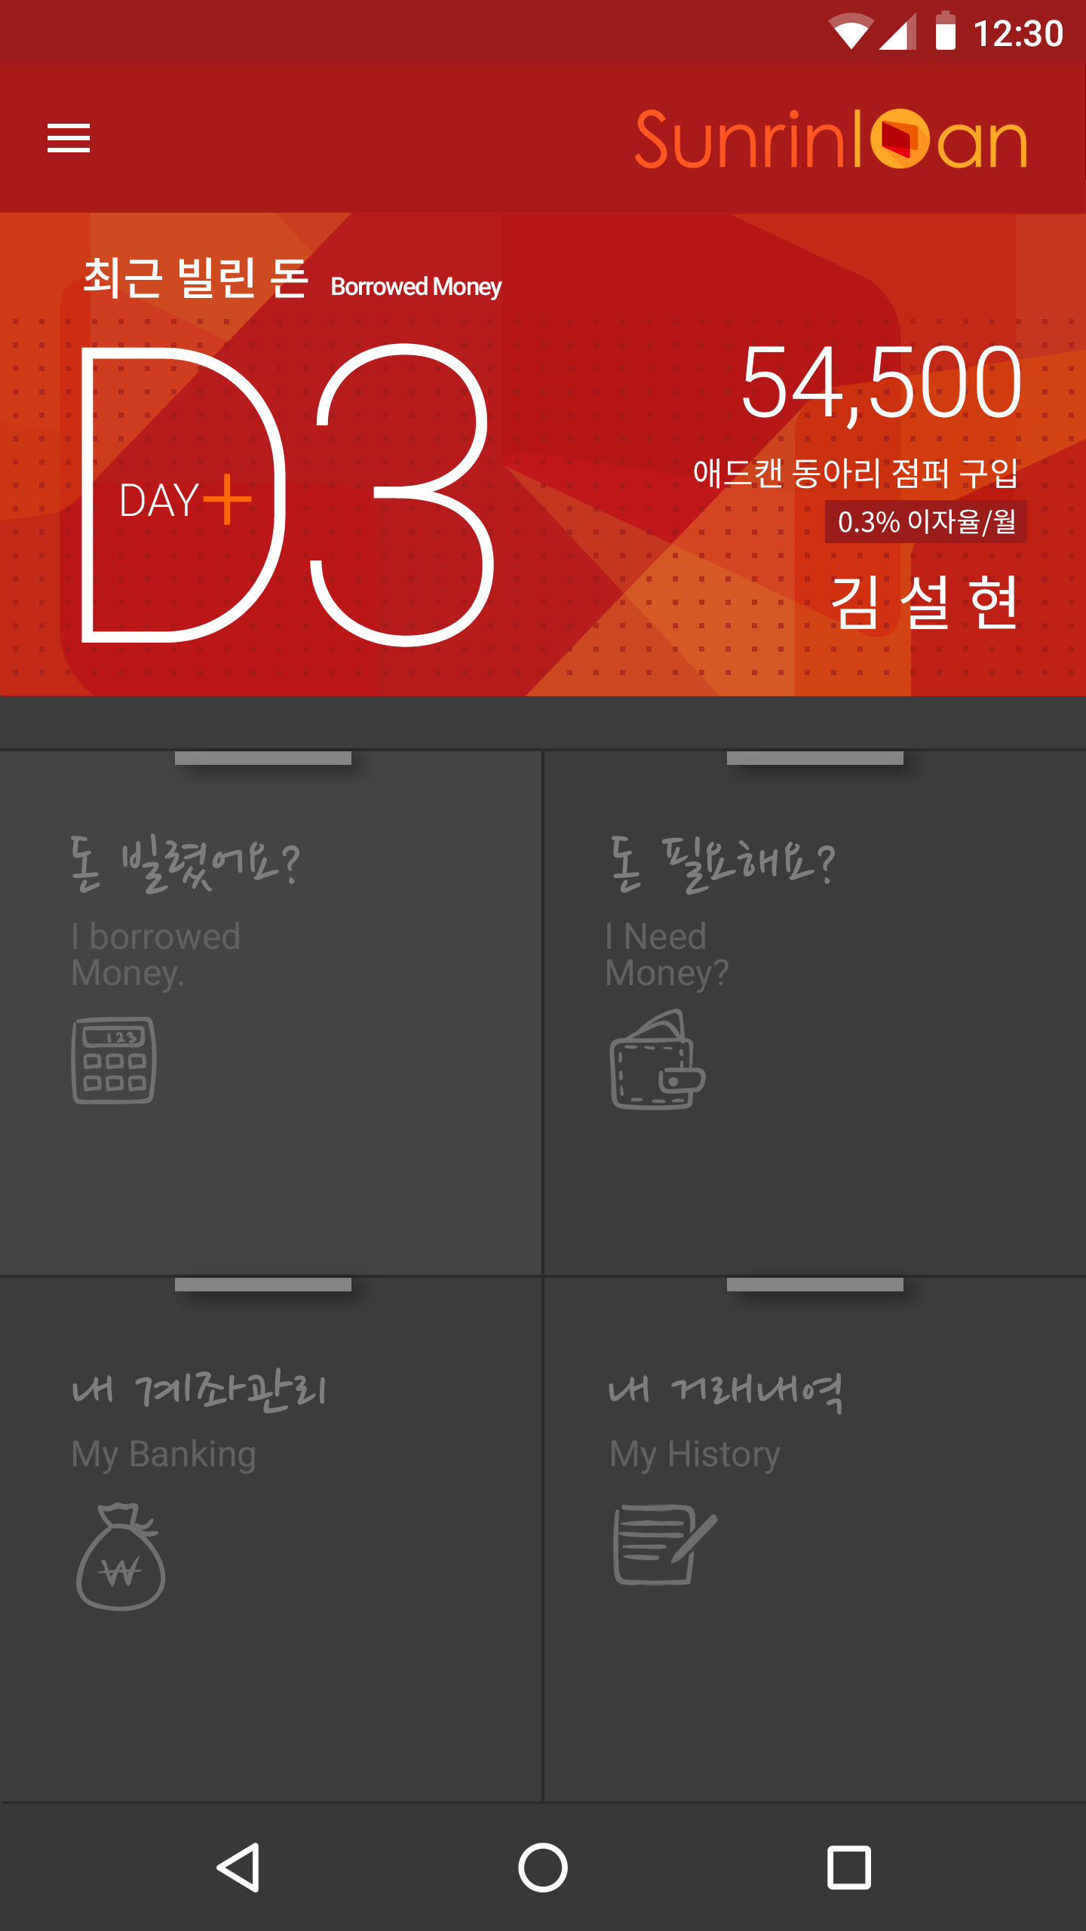
#a91a1a
15.50dp
Noto Sans CJK KR Medium 160sp
80sp
Roboto Light 288.89sp
13dp
Noto Sans CJK KR 레귤러 97.78sp
Roboto Thin 1222.22sp
6.75dp
Noto Sans CJK KR 레귤러 80sp
13dp
Noto Sans CJK KR 레귤러 177.78sp
우측마진 전부 21.75dp
28dp
200sp
7.75dp
106.67sp
color="#3c3c3c"
1dp
MAIN PAGE

Slide 5
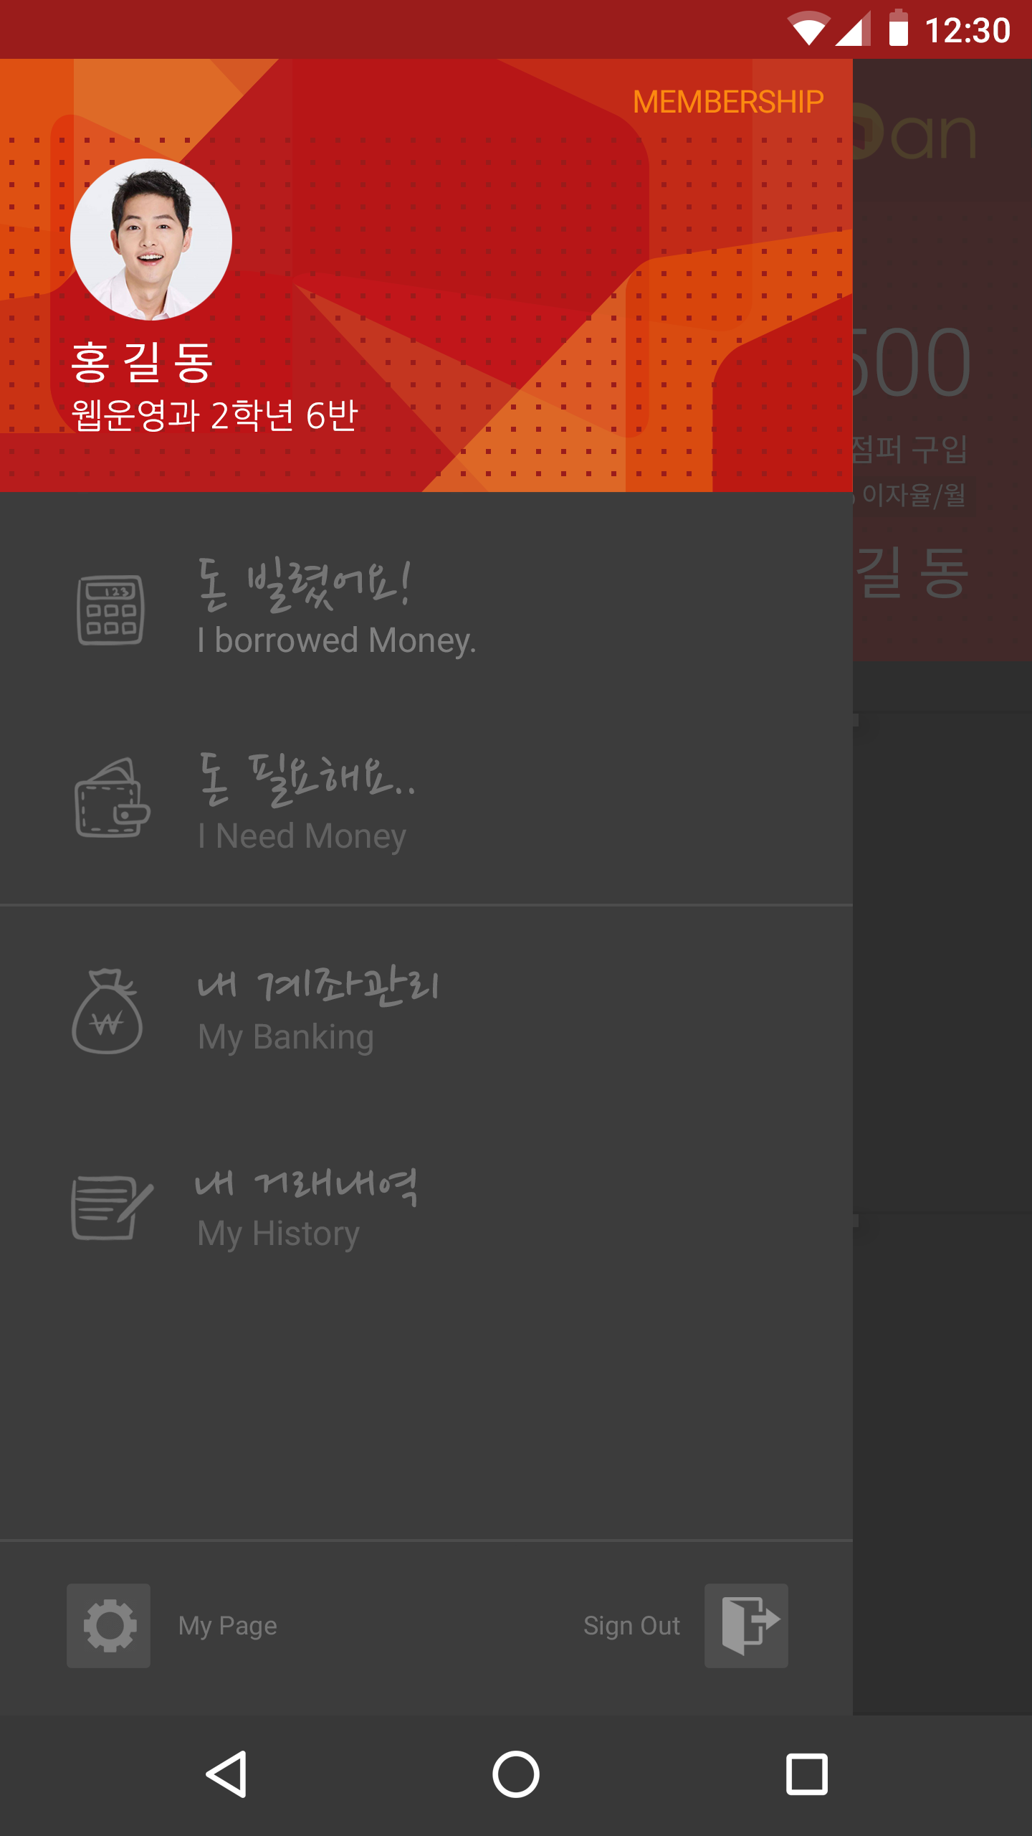
36dp
26dp
Line:1dp
63dp
1dp
36dp
63.50dp
DRAWER PAGE

Slide 6
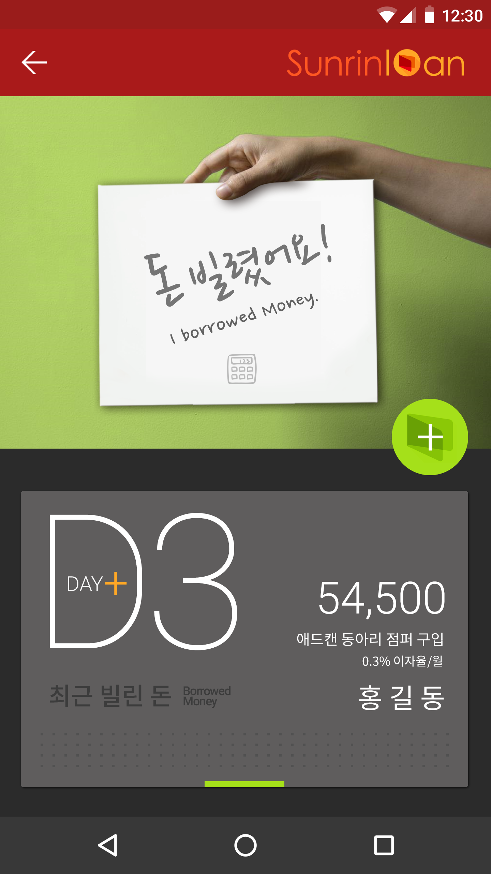
20dp
15.50dp
16dp
31dp
9.25dp
65dp
16dp
Roboto Light 288.89sp
13.50dp
17.25
dp
메인 화면과 동일
Noto Sans CJK KR Regular 97.78sp
7.25dp
Noto Sans CJK KR Regular 80sp
13.25dp
Noto Sans CJK KR Regular 177.78sp
이름 사이 간격 스페이스바 한번
다음 카드와의 간격 5dp
BORROWED PAGE

Slide 7
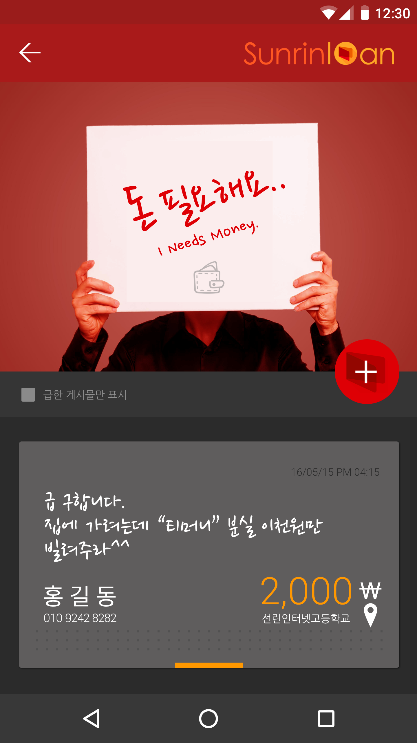
20dp
15.50dp
19.75
dp
80sp
39dp
16dp
11.25dp
21.25dp
19.75dp
Roboto Light 80sp
14.50dp
20
dp
나눔 손글씨 펜 195.56sp
16dp
177.78sp
한글: Noto Sans CJK KR Regular
숫자: Roboto Light
288.89sp
88.89sp
80sp
9dp
다음 카드와의 간격 5dp
NEED PAGE

